Slide 1
SC2001
Project 1
Team Members:
Chong Wei Kang
Ng Xuan Yi
Sanskkriti Jain
Notes:
Good morning prof, we are group 1 of this lab group and today, myself together with Xuan Yi and Jain, we will be presenting on Project 1 of SC2001 which is on the integration of insertion sort and merge sort.

Slide 2
Project 1: Integration of InsertionSort & MergeSort
1
Algorithm Implementation
Implement and analyze the hybrid algorithm.
2
Analyze time complexity
Determine optimal value of S
3
Compare with original MergeSort
Determine if the hybrid algorithm is actually better
Notes:
We will start with introducing the implementation of the algorithm, continued by analyzing the time complexity and deterimning the optimal value of S, and finally,we will end off by comparing with the original mergesort and determine whether the hybrid algorithm was actually better.

Slide 3
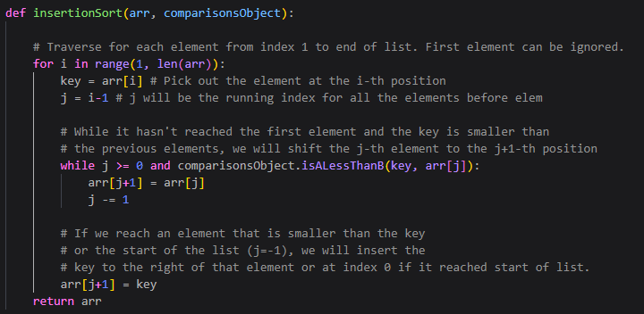
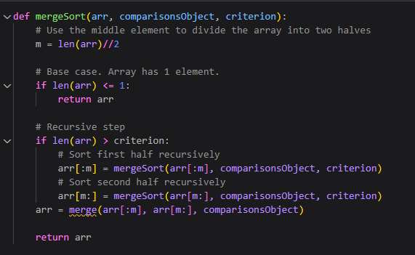
Part (a): Algorithm Implementation
Insertion Sort
Merge Sort
Notes:
Moving on to part a on the implementation of the algorithm, on the left of the slide, you see the algorithm for our insertion sort and on the right side, that’s our merge sort algorithm, which is rather similar to what we learnt in the lectures.

Slide 4
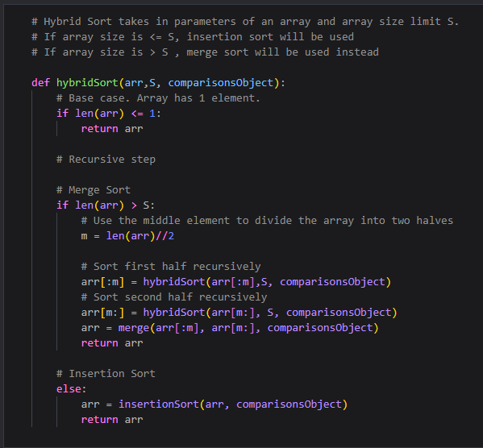
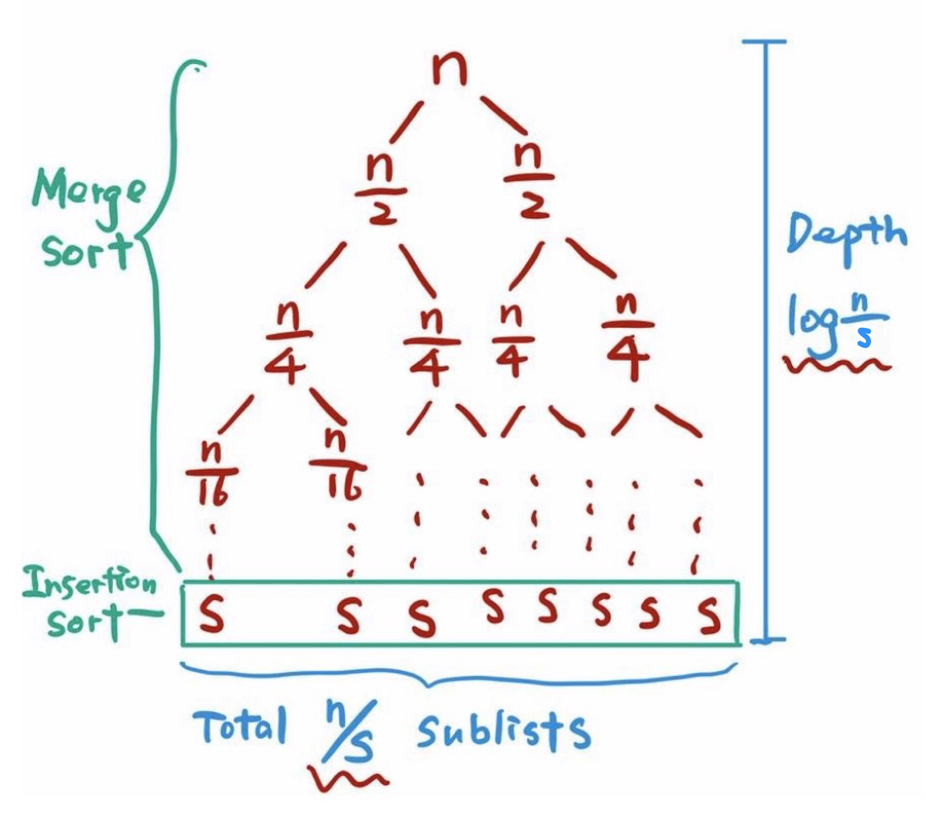
Part (a): Algorithm Implementation
Hybrid Sort Recursion Tree
Notes:
The more interesting algorithm is actually the hybrid algorithm, where if the array size is greater than the threshold size S, merge sort will be utilised. If the array size is <= S, we will be utilising insertion sort instead. Here, you can see the hybrid sort recursion tree which depicts what I have just mentioned in detail. For example, if we have an array of size n, we will keep splitting the array into 2 until the size of the array is <= S. Then, we would have a total of n/s sublists. The depth of the whole tree will be log(n/s) as it’s log(n) - log(s). log(n) is the original height of the tree if only merge sort is utilised, and we subtract it by log(s) as in this case, we are utililsing insertion sort instead when the the array size is <= S.

Slide 5
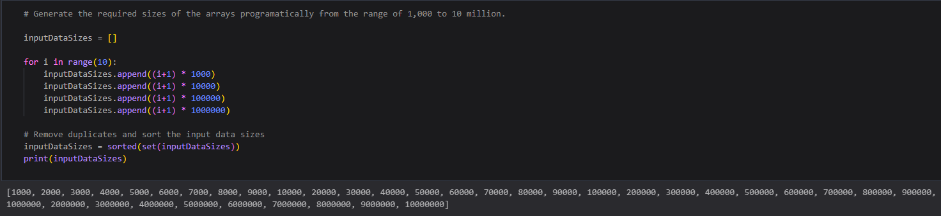
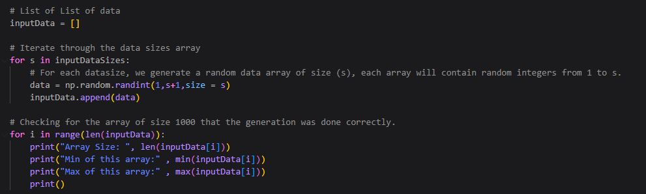
Part (b): Generate input data
Generating Input Data Array Sizes
Generating Data
Notes:
Moving on to part b, we first started by generating the input data array sizes from 1000 to 10million. Then after that we proceeded to generate the actual data itself which ranged from 1 to the size of the array itself.

Slide 6
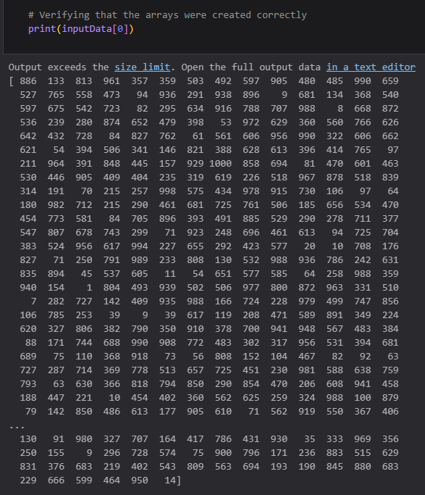
Part (b): Generate input data
Manual verification
Notes:
After we generated the data, we first tried utilising our eyepower to verify whether the array had been created properly, but soon realised that it was a little tedious

Slide 7
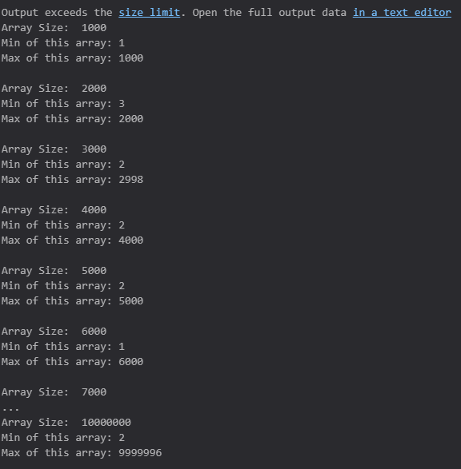
Part (b): Generate input data
Verifying programmatically through checking the length, min and max of each generated array
Notes:
Hence, we decided to verify it programmatically through checking the length, min and max of each array. The min should be close to 1 and the max should be close to the size of the array. Hence, using this method, we verified that the random array was generated correctly. I will now pass on my time to Jain to bring us through part ci and cii.

Slide 8
Part (c)(i): Analysis of time complexity
Theoretical Analysis
Insertion Sort Algorithm on n/s array, with each size is s
Best Case: O(s)
Worst Case : O(s²)
Upon implementing hybrid Algorithm
Best Case: (n/s) * s = O(n)
Worst Case : (n/s) * (s²) = O(ns)
Notes:
Thank You Wei Kang,
Moving on to the analysis of time complexity:
We know the average and worst-case time complexity of Insertion Sort is O(s²) where s is the array size. Thus, the total time complexity of the Insertion Sort component of our hybrid algorithm is: ….
n/s is the number of groups of size s as we divide n elements into n/s groups of size s

Slide 9
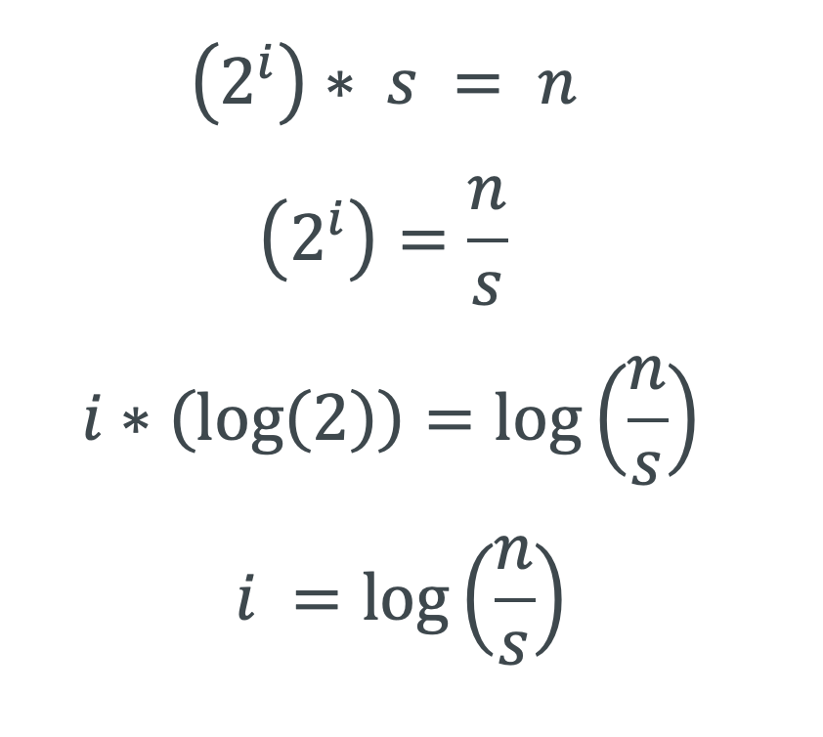
Part (c)(i): Analysis of time complexity
Theoretical Analysis
Merge sort Algorithm with
array size, s
Suppose we have to do i iterations in merge sort to merge the sorted parts:
Best & Worst Case: log(n/s)
Upon implementing Hybrid Algorithm
Best & Worst Case:
n * log (n/s)
Notes:
Next, we perform the Merge operation on the sorted arrays.
Each level compares n elements. Therefore, the total time complexity of the Merge Sort component of our hybrid algorithm is:....
n x log (n/s) = O(n log (n/s))

Slide 10
Part (c)(i): Analysis of time complexity
i. Fixed S value
Total time complexity of the Hybrid Algorithm:
Insertion Sort + Mergesort = Hybrid Algorithm
Best Case: O(n + n log (n/s))
Worst Case: O(ns + n log (n/s))
When s is fixed, making it a constant the time complexity can be simplified to:
O(n + n log (n)) = O(n log (n))
Notes:
Hence, the total time complexity of the hybrid algorithm is:
When s is fixed, the time complexity of the hybrid algorithm can be simplified to
*O(n + n log n)* = *O(n log n), as long as s does not approach n.

Slide 11
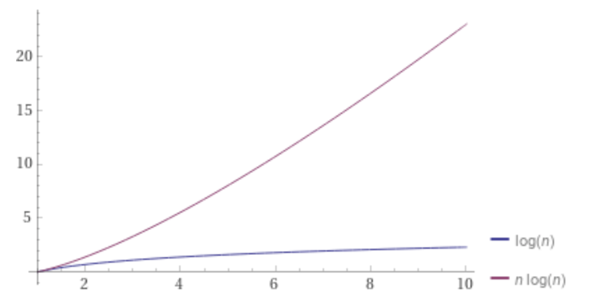
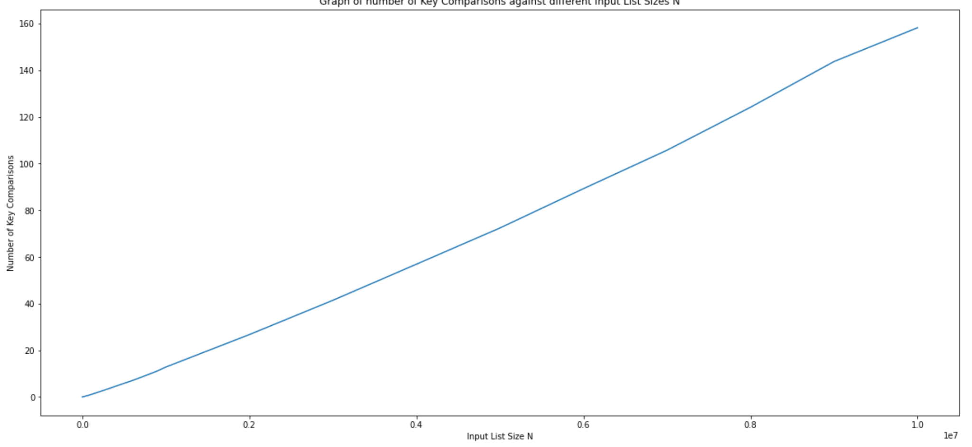
Part (c)(i): Analysis of time complexity
Comparing it to Empirical Data
Plot of elapsed time v/s Input list size, n
With s value set to 10
Plot of n log(n)
Notes:
Now to compare our theoretical data with the empirical Data
Since we set our s to be very small, at 10 , we expect our time complexity to be O(n log n).
Indeed, following the comparison of both key comparisons and elapsed time, the hybrid algorithm does show a time complexity which is similar to the pure merge sort algorithm of *O(n log n)*.

Slide 12
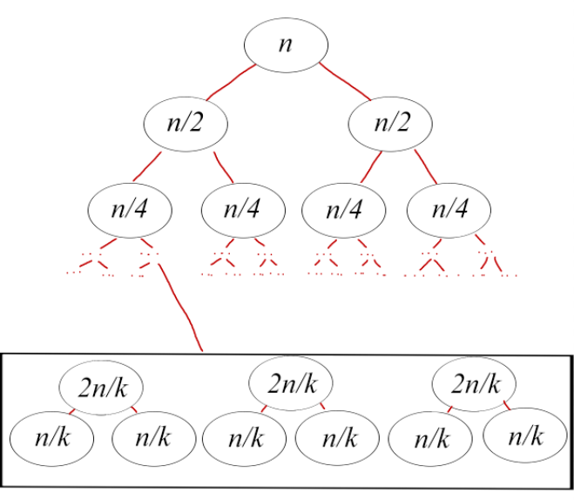
Part (c)(ii): Analysis of time complexity
Consider an array of size n, and set the threshold to be s = n/k.
The merge sort method splits the array into k n/k-sized subarrays,
We change the value of s to be such that 2n/k < s < n/k.
Change the value of s to be 2n/k.
Notes:
Moving on to the fixed value of n
To explain this theoretically,
Consider an array of size n, and set the threshold size to be s = n/k. Here n is the fixed array size, s is the threshold and, k is the number of iterations or comparisons in that level.
When the mergesort method splits the array into k n/k-sized subarrays, the Insertion Sort method will only be called when the array size is ≤ s.
Now suppose we change the value of s to be such that 2n/k < s < n/kNotice that since subarray of size 2n/k is bigger than s, the Merge Sort algorithm will be called on the level of array size 2n/k instead. The Insertion Sort algorithm will only be called on the level of array size n/k.
Now suppose we change the value of s to be 2n/k. Then, the Insertion Sort algorithm will be invoked on the level of array size 2n/k instead as that is the greatest possible array size value for the insertion sort to operate on.
This shows that whenever the value of s is strictly between the array size of two adjacent levels in the binary tree structure, the number of Insertion Sort method called is the same which means the number of key comparisons is the same.
The plot of number of key comparisons against the threshold size presents a staircase pattern. This explains the staircase pattern shown in the plot, where the levelled region is when 2n/k ≤ s ≤ n/k and the spike region is when s = 2n/k or s = n/k.
We shall determine the optimal threshold value in C Part 3.

Slide 13
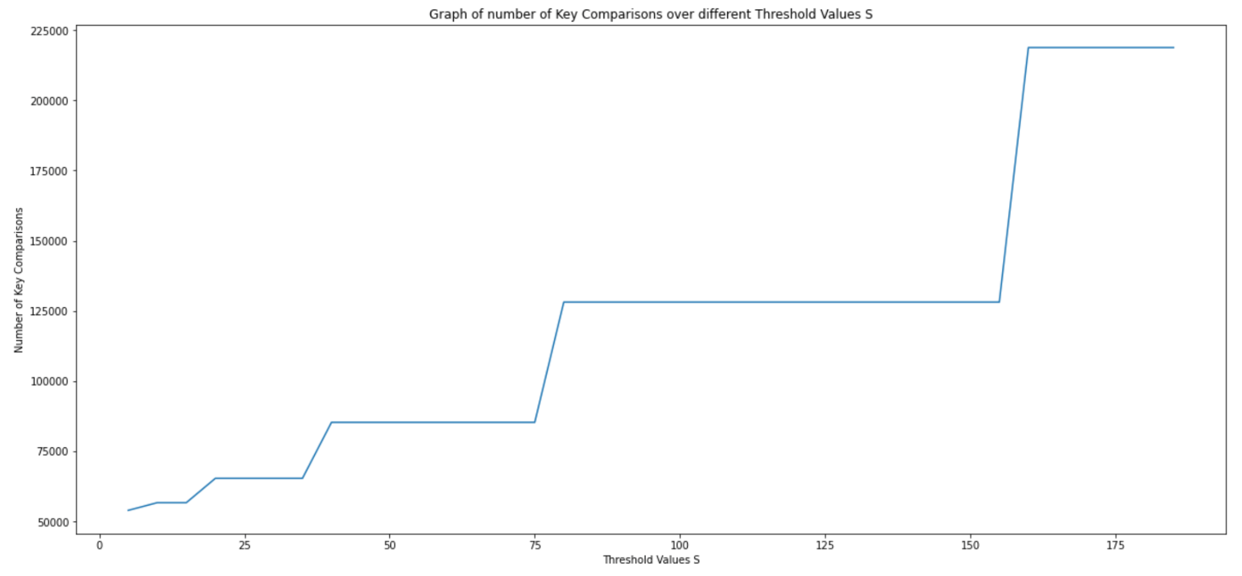
Part (c)(ii): Analysis of time complexity
This explains the staircase pattern shown in the plot, where the leveled region is when 2n/k ≤ s ≤ n/k and the spike region is when s = 2n/k or s = n/k.
Notes:
The plot of number of key comparisons against the threshold size presents a staircase pattern. This explains the staircase pattern shown in the plot, where the levelled region is when 2n/k ≤ s ≤ n/k and the spike region is when s = 2n/k or s = n/k.
We shall determine the optimal threshold value in C Part 3.

Slide 14
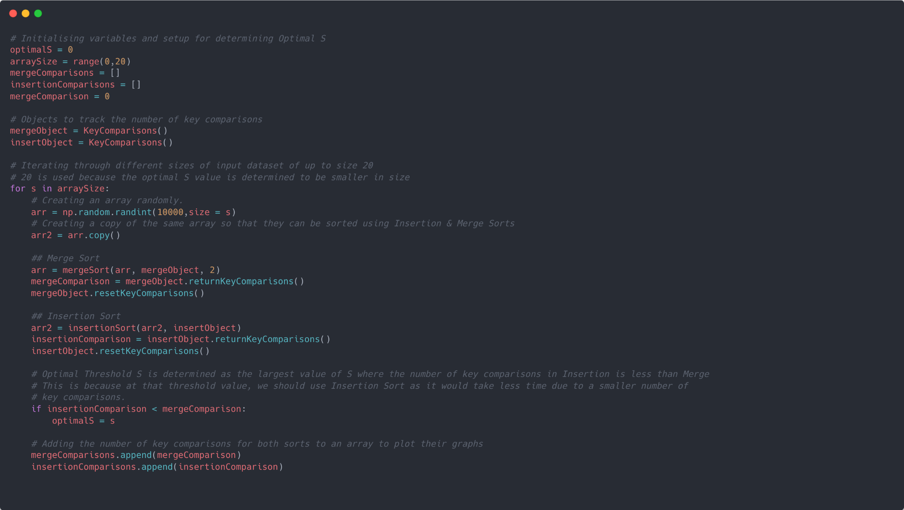
Part (c)(iii): Determining the optimal threshold value, S, for the Hybrid Sort
Mechanism to determine S
Determined by varying the sizes of the input datasets from 0 to 20.
Input dataset sizes were determined as initial plots showed that insertion sort has a smaller number of key comparisons at smaller sizes.
Moreover, from theoretical analysis, insertion sort is fast only at small input sizes.
Optimal threshold was determined by taking the largest array size value where number of key comparisons for insertion sort is less than that of merge sort.
Notes:
Thank you Jain, I will now be going through the last 2 questions, part ciii and part d. For Q1ciii, we are tasked to determine an optimal value of S, which will allow the hybrid sort algorithm to sort through the array in the fastest possible time. This is because insertion sort is efficient and faster than merge sort at smaller input array sizes, thus a very small S would cause the algorithm to split unnecessarily, slowing down the sort. Conversely, a very large S would slow the algorithm as it would have been faster to further split the array.
Moving on, the optimal S value can be determined by using input datasets of various sizes from 0 to 20. A relatively smaller range of array size was used since our initial plots showed that insertion sort has a smaller number of key comparisons than merge sort only at smaller threshold values. Additionally, from our domain knowledge, we are aware that insertion sort is only efficient at smaller sizes since it has a worst time complexity of O(n^2). The results gathered will be used to plot a graph of the number of key comparisons against array sizes, which is shown in our next slide.

Slide 15
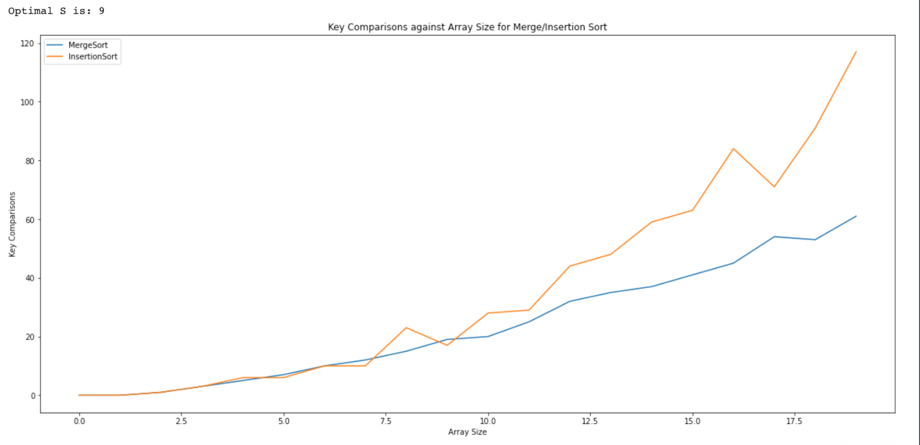
Part (c)(iii): Determining the optimal threshold value, S, for the Hybrid Sort
Final Decision
3 candidates for an optimal value, S, because Insertion sort uses less key comparisons, and thus time to sort than Merge sort.
However, threshold value S is optimal at 9 because theoretical analysis of Merge sort proves that it is inefficient at smaller input sizes.
Candidates for optimal threshold S
Notes:
Our S can be found at the point where the graph for insertion sort dips below that of merge sort, as insertion sort takes less key comparisons and thus time at that point. As the graph shows, there are currently 3 points where the graph for insertion sort dips below that of merge sort, which are our candidates for the value of S. However, we chose the largest S value from our candidates at 9 so as to avoid splitting the array into even smaller sizes as it would be inefficient for merge sort.

Slide 16
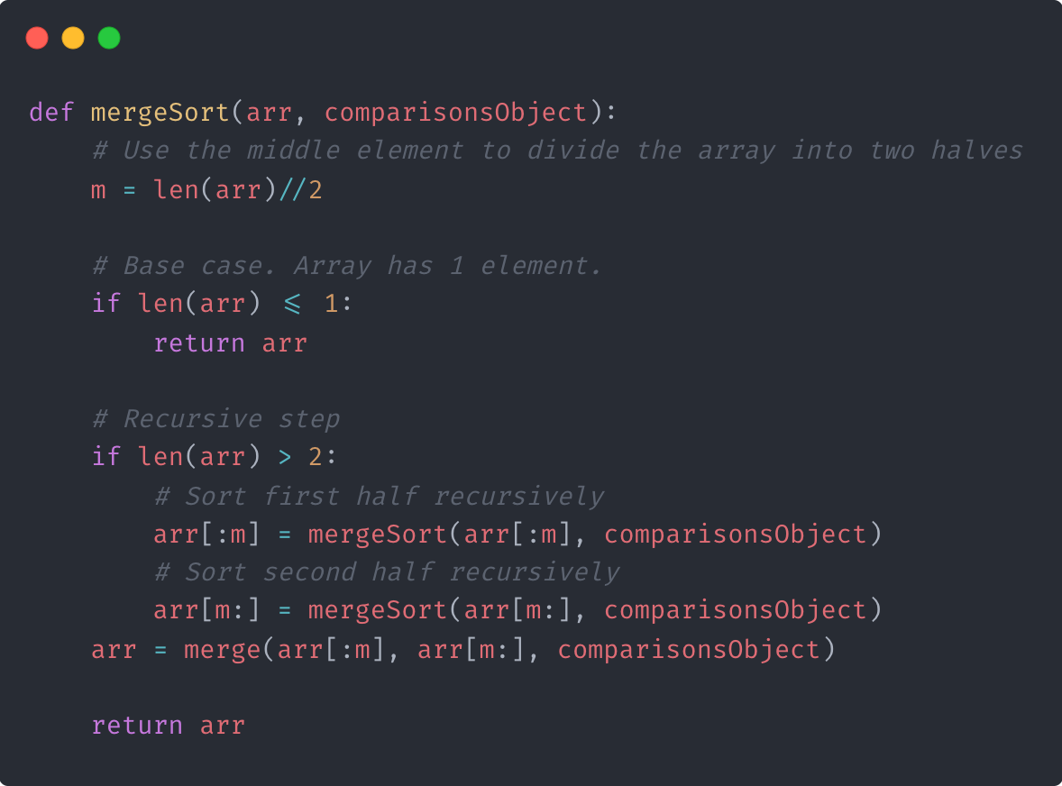
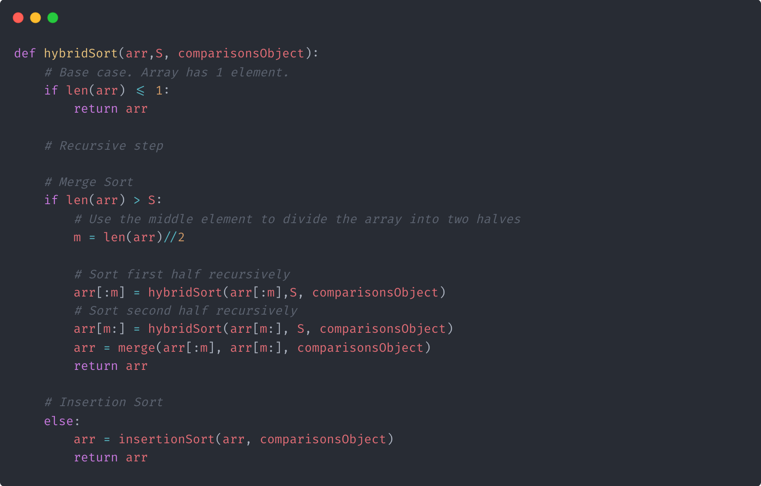
Part (d): Comparison with Original Mergesort (Theoretical)
Merge Sort
Insertion Sort

Slide 17
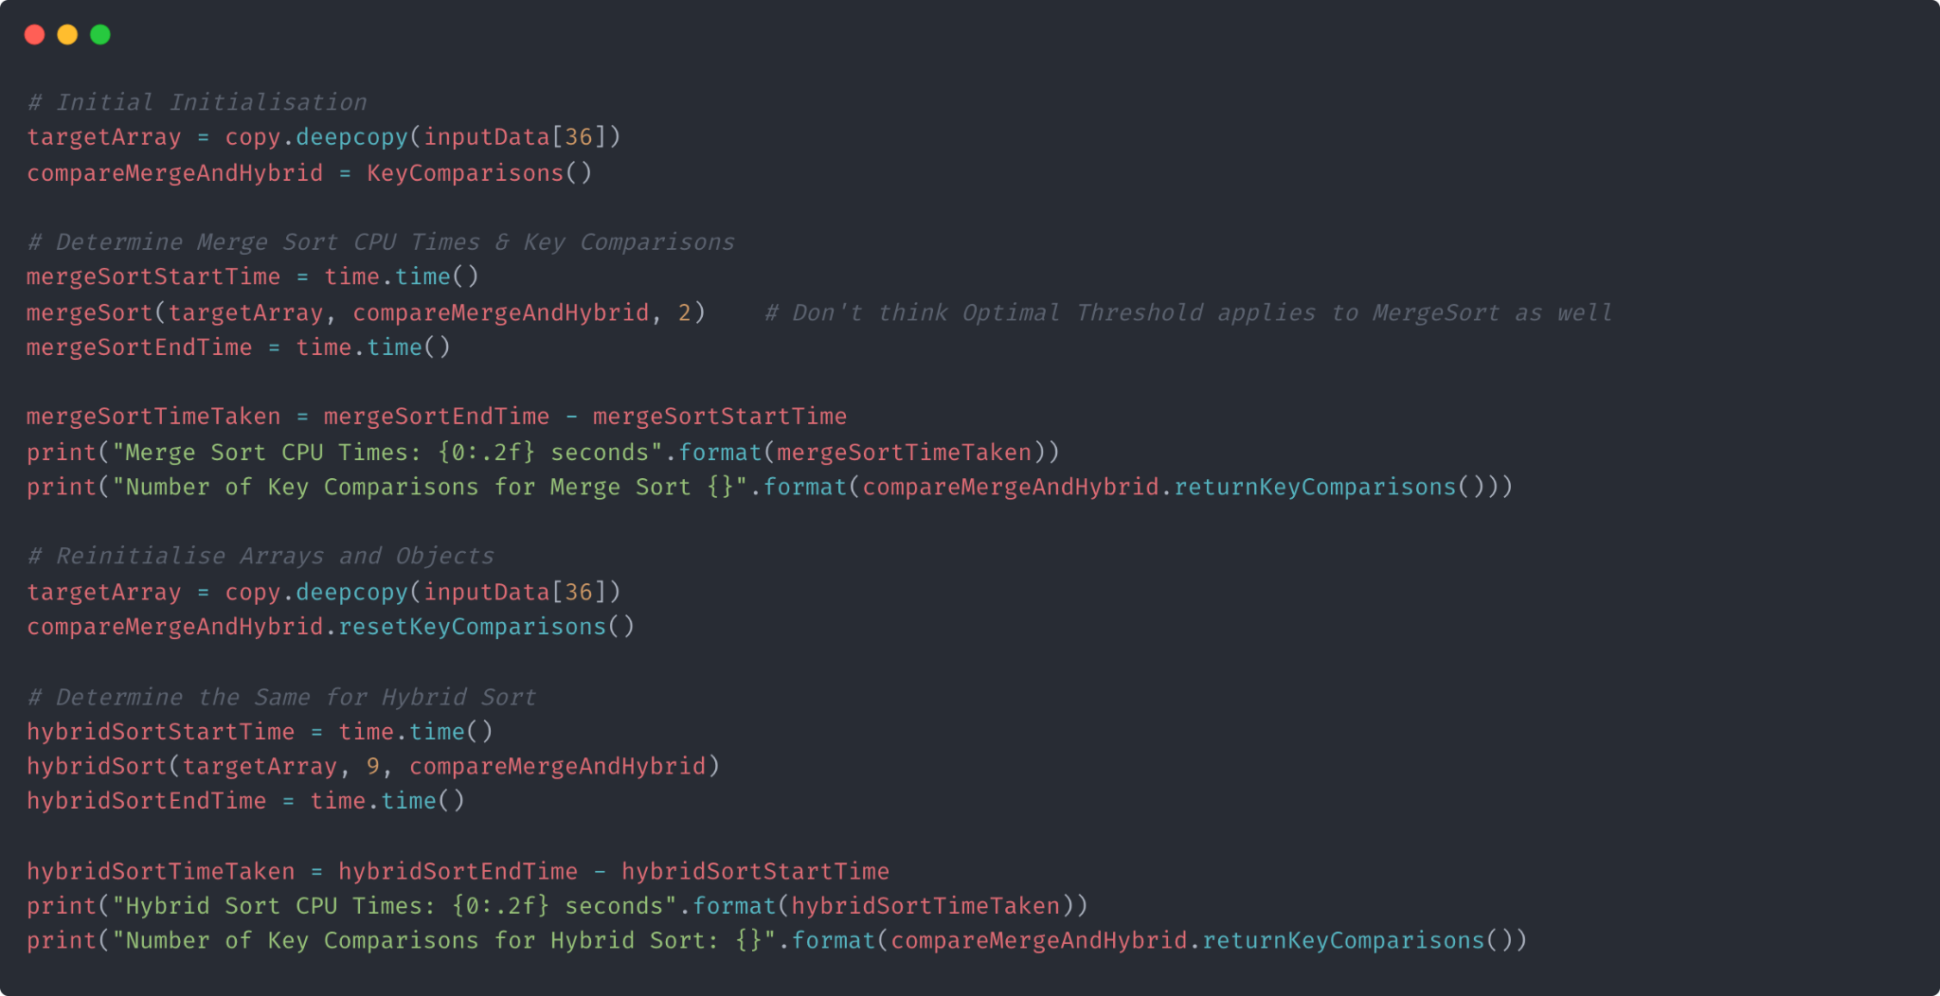
Part (d): Comparison with Original Mergesort (Implementation)
Mechanism to compare both Sorts:
Create a deep copy of a random array of input size 10 million.
Call merge sort and hybrid sort on each separate array, where the S value used in hybrid sort is 9.
Determine the number of key comparisons and time taken for each sorting method.
Notes:
Moving on to part (d), we created a random array of size 10 million, and created a deep copy of the same array to ensure that the comparison is conducted fairly. We then called merge and hybrid sort one each of the array, using the optimal S value of 9 that we discovered in the earlier part. Finally, we recorded the number of key comparisons and time taken.

Slide 18

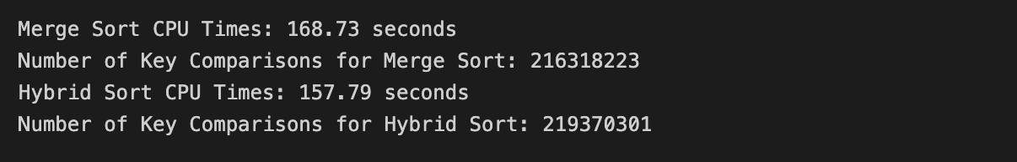
Part (d): Comparison with Original Mergesort (Actual)
Final Results:
Hybrid Sort was roughly 10 seconds faster than Merge Sort in sorting an array of size 10 million.
Surprisingly, Hybrid Sort also has a higher number of key comparisons than Merge Sort which could be explained:
Insertion Sort being faster at smaller array sizes
Insertion Sort has more key comparisons than Merge Sort.
Notes:
As you can see on the slides, hybrid sort is approximately 10 seconds faster than merge sort when sorting an array of size 10 million. Surprisingly, hybrid sort has a higher number of key comparisons than merge sort, despite having a much shorter running time. However, this makes sense as insertion sort is not only faster at smaller input array sizes, it also has more key comparisons than merge sort, thus explaining the phenomenon we observe.

Slide 19

THANK YOU FOR YOUR TIME!
Notes:
With that, we would like to end our presentation. Thank you.

